Slide 1


Smart campus assistant

Slide 2
CONTENTS
1
Demand analysis
3
Feasibility analysis
2
Functions introduction
4
Organization of work

Slide 3
Part One
Demand Analysis

Slide 4

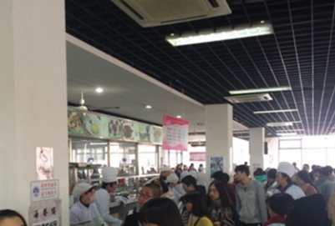
1、Demand analysis
For convenience
Have market conditions
Potential
Sustainable
Hardware conditions are available
& Supported by :
Development platform
Real video datasets
Image processing technology
User-oriented
Reliable interaction logic

Slide 5
2、Functions introduction
User-oriented
Scenario recommendation
People flow query
Users can select different scenarios to view real-time people flow scenarios
Scenario recommendations are made based on the user's own preference selection and traffic analysis
Tell users during peak hours, low peak hours, and normal periods in different scenarios
Users can select different scenarios to understand the general changes in the flow of people
Scenario reproduction
People flow forecasting

Slide 6
2、Functions introduction
Development-oriented
identify
People flow analysis
Calculate the data
Video
---->
Frame
---->
idengtify human
---->
Algorithm better
Get the data
---->
Data matching
---->
Preliminary processing of data
Enter the model
(include database)
---->
Data interaction calculation

Slide 7
3、Feasibility analysis
Open datasets
01
Easy to verify and test
Scope of application confirmation
Hardware support
Videos are physically accessible
Mobile phones are universal
02
Development tools
03
Easy to verify and test
Scope of application confirmation
Proven algorithm
An algorithmic model that can be determined
It's universal
04

Slide 8
4、Organization of work
——4 members for our team
Zhang Hongwei
Chen Meihan
Chen xinyi
Tang yaqin
单击此处编辑
单击此处编辑
单击此处编辑您要的内容，建议您在展示时采用微软雅黑字体。
单击此处编辑
单击此处编辑您要的内容，建议您在展示时采用微软雅黑字体。
单击此处编辑
单击此处编辑您要的内容，建议您在展示时采用微软雅黑字体。
单击此处编辑您要的内容，建议您在展示时采用微软雅黑字体。

Slide 9
4、Organization of work
——Stage goals and timelines
1
3
2
4
单击此处编辑
单击此处编辑
本模版所有图形线条及其相应素材均可自由编辑、改色、替换。
本模版所有图形线条及其相应素材均可自由编辑、改色、替换。
单击此处编辑
单击此处编辑
本模版所有图形线条及其相应素材均可自由编辑、改色、替换。
本模版所有图形线条及其相应素材均可自由编辑、改色、替换。

Slide 10
Thank you

